Slide 1
DiaBite.ai
A Context-Aware Diabetic Food Recommendation and Smart Ordering System
Presented by: Narasimha Purna K (23MIA1136)
Vallurupalli Manoghna(23MIA1154)

Slide 2
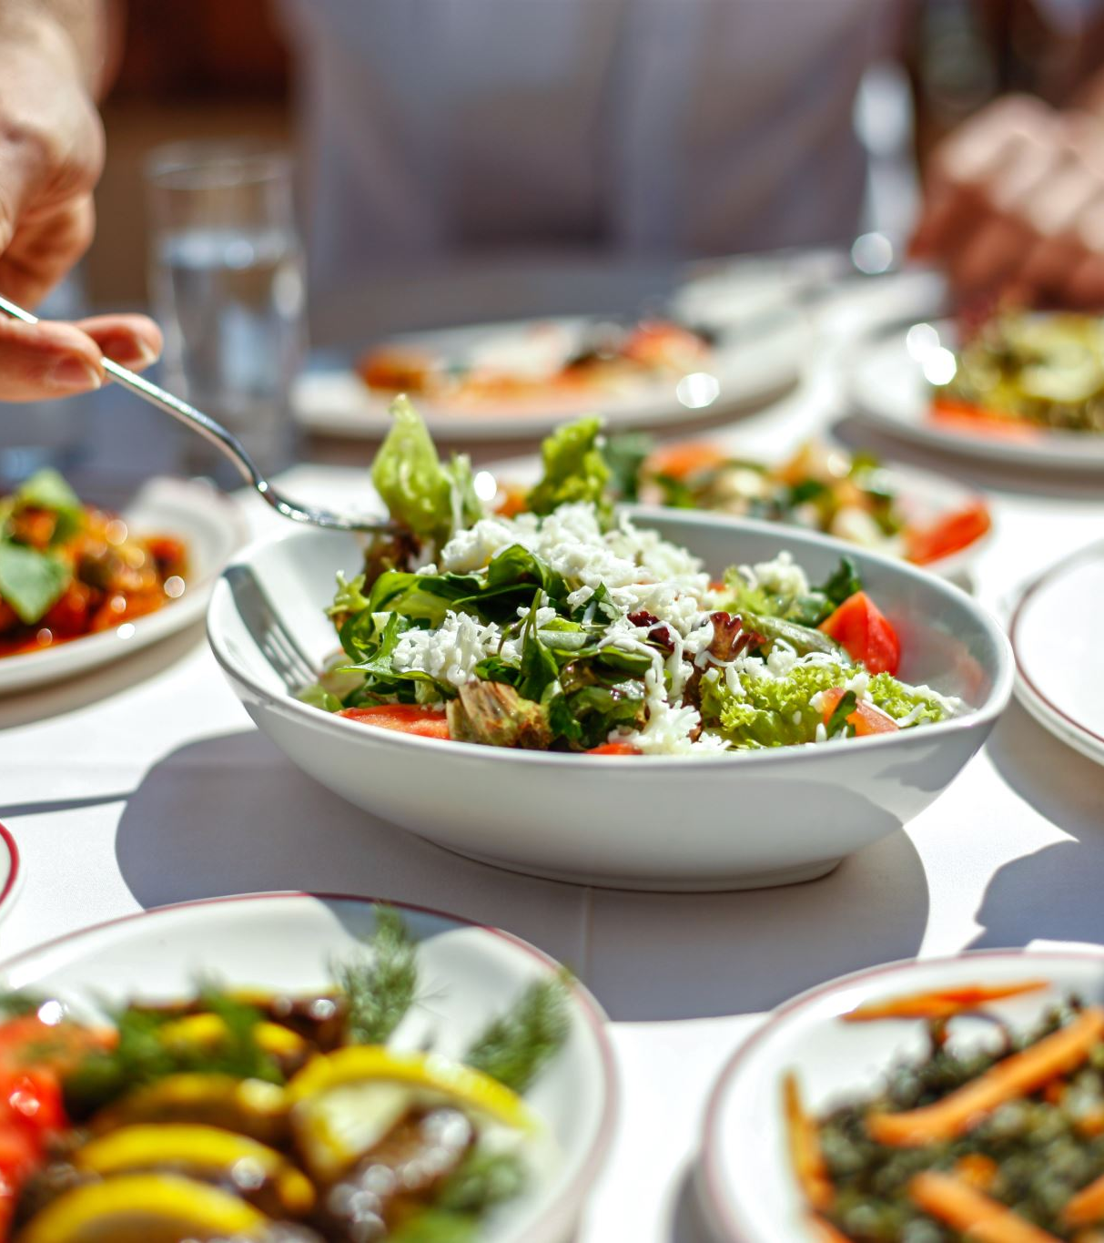
Introduction
Diabetes requires careful food selection and blood glucose management.
Conventional food delivery apps mainly focus on price, ratings, popularity, and preferences.
These factors do not adequately consider individual health requirements.
DiaBite.ai recommends meals by combining nutritional information, Glycemic Load (GL), budget, and restaurant distance.
The system also provides smart ordering instructions and post-meal glucose feedback.

Slide 3
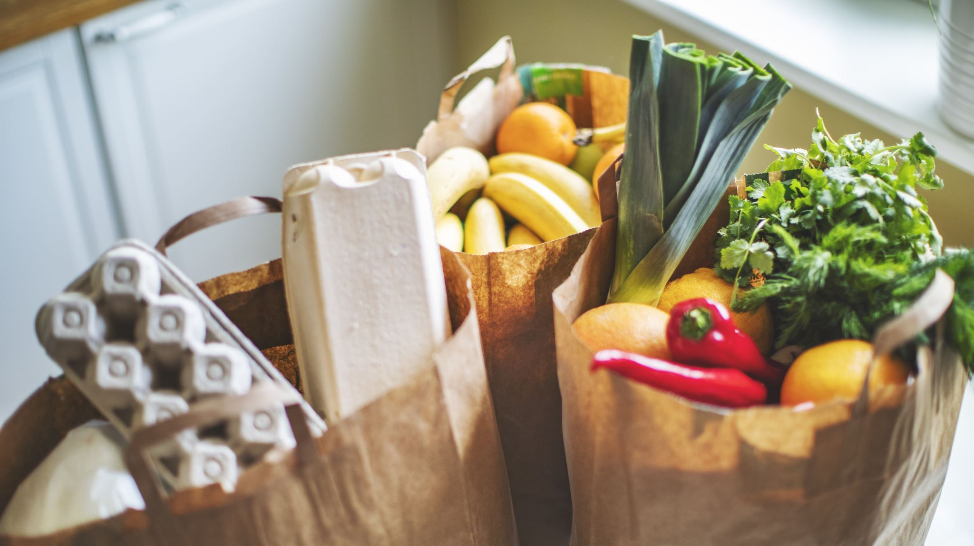
Problem Statement
Existing food delivery platforms do not sufficiently prioritize diabetic users' nutritional requirements.
Meals with similar prices and ratings may have different carbohydrate content and Glycemic Load.
Users may struggle to balance health requirements, affordability, and restaurant proximity.
Most systems do not combine health-aware recommendations with ordering support and feedback in one workflow.
Problem to solve: How can we recommend suitable restaurant meals for diabetic users while considering health, budget, and distance?

Slide 4

Objectives
Develop a personalized food recommendation system for diabetic users.
Evaluate meals using nutritional information and Glycemic Load.
Filter meals that violate dietary restrictions or health constraints.
Rank suitable meals using Multi-Criteria Decision Making (MCDM).
Provide explainable recommendations and diabetic-friendly ordering instructions.
Use post-meal glucose feedback as a basis for future personalization.

Slide 5
Dataset and Data Sources
1. Indian Food Composition Tables (IFCT 2017)
Published by ICMR–National Institute of Nutrition (ICMR–NIN).
Provides nutritional composition data for Indian foods.
Supports nutritional evaluation using available food composition values.
Used as a reference for food nutrition analysis.
2. API-Based Data Retrieval
Uses an API key to access an external data service.
Retrieves data supported by the integrated API.
Supports data retrieval for relevant application features.
3. Data Processing and Application
Processes available nutritional and external data.
Uses Glycemic Load (GL) for meal evaluation when the required inputs are available.
Applies health filtering and Multi-Criteria Decision Making (MCDM) for meal ranking.
Generates meal recommendations based on configured health, budget, and distance criteria.

Slide 6
Existing System vs Proposed System
Existing System | Proposed DiaBite.ai
Price and rating-based ranking | Health-aware meal ranking
General food preferences | Personalized health and dietary profile
Limited glycemic consideration | Glycemic Load-based evaluation
Separate consideration of price and location | Combined health, budget, and distance criteria
Limited recommendation explanation | Explainable recommendation scores
Standard ordering process | Customized ordering instructions
Limited feedback-based personalization | Post-meal glucose feedback

Slide 7
Proposed System
DiaBite.ai integrates patient information, food nutrition, and restaurant data to recommend suitable meals.
Patient data: Diabetes type, BMI, HbA1c, dietary preferences, allergies, budget, and location.
Food data: Calories, carbohydrates, protein, fat, fiber, and Glycemic Index.
Restaurant data: Dish availability, price, latitude, and longitude.
Health filtering: Removes meals that do not satisfy specified constraints.
MCDM ranking: Combines normalized health, budget, distance, and other configured criteria.
Output: Ranked meals, explanations, ordering instructions, and feedback recording.

Slide 8
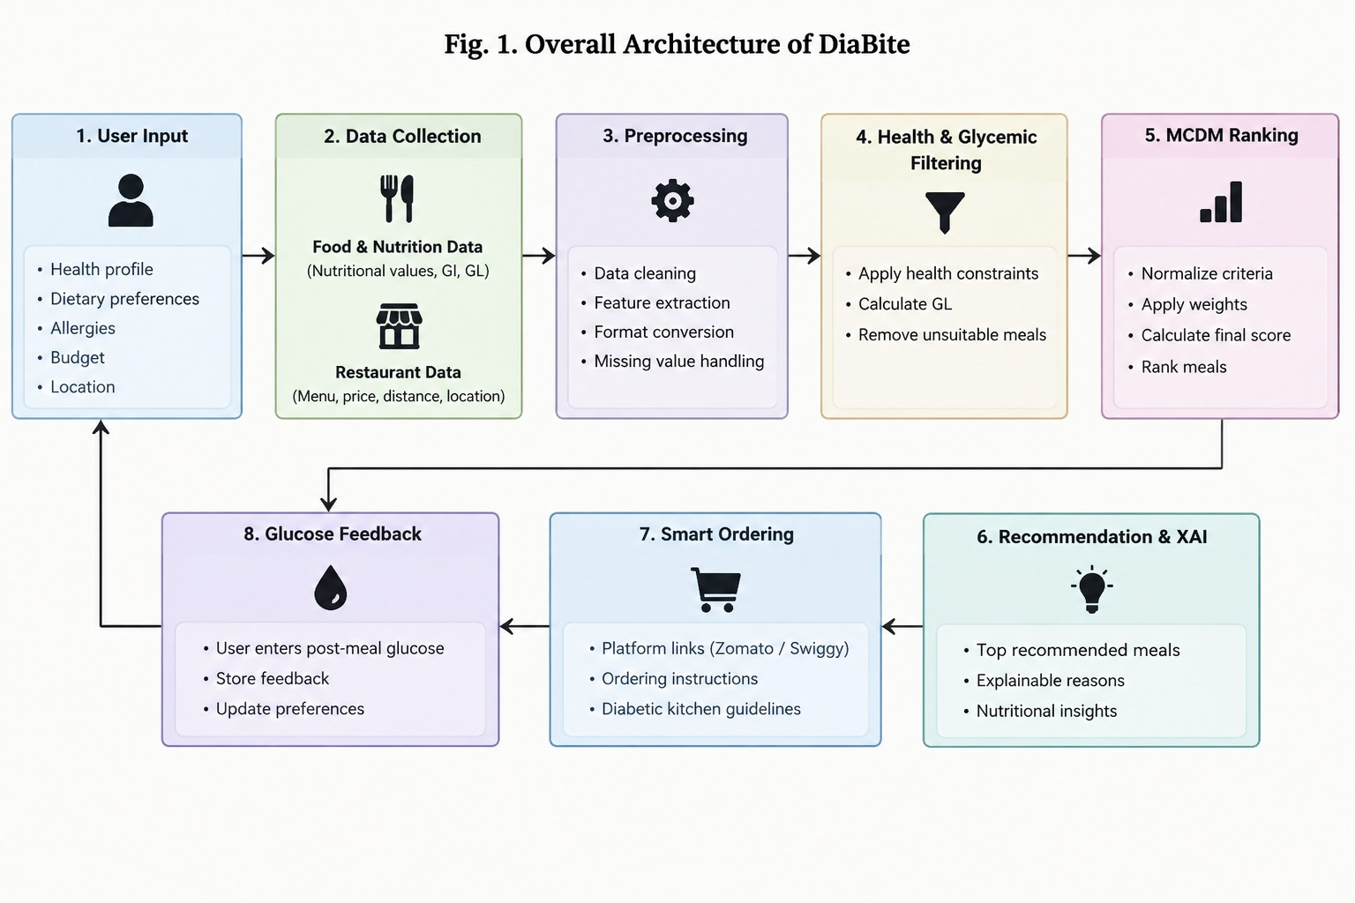

Slide 9
Glycemic Load (GL) Calculation
Glycemic Index (GI):
Indicates the relative effect of carbohydrate-containing food on blood glucose.
GI alone does not consider the amount of carbohydrates consumed.
Glycemic Load (GL):
Considers both Glycemic Index and available carbohydrates per serving.
Helps evaluate meals for diabetic food recommendations.
Formula:
GL = (GI × Available Carbohydrate (g)) / 100
Example:
GI = 50
Available Carbohydrate = 20 g
GL = (50 × 20) / 100 = 10
Key Point: DiaBite.ai uses GL as one of its health-related criteria when comparing meals. A lower GL indicates lower expected glycemic impact, all else being equal.

Slide 10
MCDM and Weighted Sum Model (WSM)
Multi-Criteria Decision Making (MCDM):
AHP (Analytic Hierarchy Process) and WSM
AHP: Determines the importance of each criterion.
Criteria: Health, Glycemic Load (GL), Budget, and Distance.
WSM: Calculates scores and ranks suitable meals.
Formula: Score = Σ (Weight × Normalized Score)
Health & Glycemic Load (GL): Highest importance
Budget: Moderate importance
Restaurant Distance: Lower importance

Slide 11
System Feature
1. Personalized Recommendations
Suggests meals based on user health information, dietary preferences, and budget.
2. Explainable Recommendations
Shows meal scores, price, GL, distance, and the main reasons behind the ranking.
3. Smart Ordering
Provides Zomato and Swiggy searches, Google Maps, and customized preparation instructions.
4. Glucose Feedback
Records meal feedback and post-meal glucose readings to support future personalization.

Slide 12
Novelty and Research Contribution
The novelty is not simply recommending food for diabetic users; it is integrating multiple decision factors into a restaurant-oriented workflow.
Health + Restaurant Context: Combines patient health information with restaurant price and geographic distance.
GL-Based Evaluation: Uses a measurable glycemic criterion instead of relying only on generic healthy-food labels.
MCDM-Based Ranking: Balances competing health, budget, and distance requirements.
Explainability: Shows the factors contributing to a meal's ranking.
Smart Ordering: Connects recommendations to practical ordering instructions.
Feedback-Based Personalization: Uses recorded post-meal glucose readings as a basis for future improvements.

Slide 13

Limitations and Future Scope
Limitations
Restaurant-specific nutrition data may be unavailable; estimates may be required.
Menu items, prices, and availability can change.
Manual glucose feedback may contain errors.
The system does not replace professional medical or dietary advice.
Future Scope
Integrate Continuous Glucose Monitoring (CGM) devices.
Connect directly with restaurant and food-delivery APIs.
Synchronize restaurant menus and prices automatically.
Use computer vision for food and portion-size estimation.
Conduct clinical validation with diabetic users.

Slide 14

Conclusion
DiaBite.ai proposes a context-aware food recommendation system for diabetic users.
It combines patient profiles, nutritional information, Glycemic Load, budget, and restaurant distance.
Health filtering removes unsuitable meals before the ranking stage.
The Weighted Sum Model combines normalized criteria to generate recommendation scores.
Explainable results, smart ordering, and post-meal feedback support a more personalized food selection process.

Slide 15
References
Yera et al. (2023) – A Systematic Review on Food Recommender Systems for Diabetic Patients.
Ahmed et al. (2025) – Diabetes-focused Food Recommender System (DFRS) to Enabling Digital Health.
Aldaghi and Muzik (2024) – Multicriteria Decision-Making in Diabetes Management and Decision Support: Systematic Review.
Rein et al. (2022) – Effects of Personalized Diets by Prediction of Glycemic Responses on Glycemic Control and Metabolic Health.
Indian Council of Medical Research – National Institute of Nutrition, Indian Food Composition Tables.
Atkinson, Foster-Powell and Brand-Miller (2008) – International Tables of Glycemic Index and Glycemic Load Values.

